Slide 1
7 HABITS OF HIGHLY EFFECTIVE PEOPLE
Powerful lessons in personal change
Stephen Covey

Slide 2


Slide 3

AGENDA
Be Proactive
Begin with end in mind
Put first things first
Think win/win
Seek first to understand
then to be understood
Synergy
Sharpen the saw

Slide 4

MATURITY CONTINUUM

Slide 5

1. BE PROACTIVE
I’m in charge of ME
I take initiative
I do the right thing
without being asked
even when no one is looking
I choose my actions
attitudes & moods
I don’t blame others
for my wrong actions

Slide 6

THE BEST WAY TO PREDICT YOUR FUTURE IS TO CREATE IT

Slide 7
Stimulus
Response

Slide 8
Stimulus
Freedom to Choose
Response
Self Awareness
Independent Will
Imagination
Conscience

Slide 9

DON’T LET THE THINGS WE CAN DO NOTHING ABOUT IT INTERFERE WITH THE THINGS WE CAN MAKE A BIG DEAL ABOUT

Slide 10

CIRCLE OF INFLUENCE
Proactive Focus Reactive Focus

Slide 11

2. BEGIN WITH THE END IN MIND

Slide 12

BEGIN WITH THE END IN MIND

Slide 13
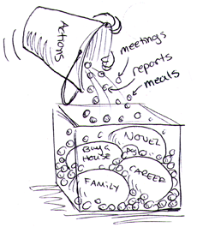
3. PUT FIRST THINGS FIRST

Slide 14

THINGS THAT MATTER MOST SHOULD NEVER BE AT THE MERCY OF THINGS THAT MATTER LESS

Slide 15
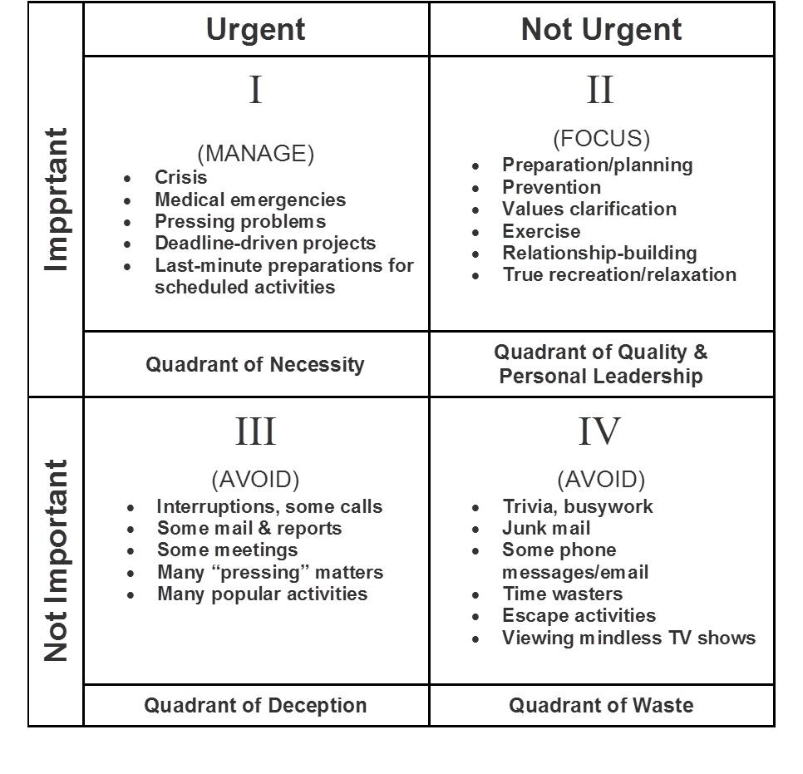
MANAGEMENT MATRIX

Slide 16

BECOMING A QUADRANT II SELF-MANAGER
Identifying Roles
Selecting Goals For Each Role
Scheduling On a Week Basis
Daily Adapting

Slide 17

THINK WIN-WIN

Slide 18

WE CAN WORK IT OUT. LIFE IS VERY SHORT, AND THERE'S NO TIME FOR FUSSING AND FIGHTING, MY FRIEND
Paul McCartney & John Lennon

Slide 19

5. SEEK FIRST TO UNDERSTAND AND THEN TO BE UNDERSTOOD

Slide 20

WITH PEOPLE FAST IS SLOW AND SLOW IS FAST

Slide 21
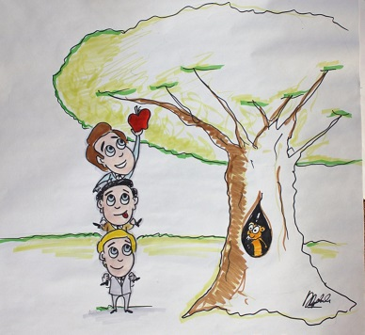
6. SYNERGY
“The whole is greater than
the sum of its parts”
Aristotle

Slide 22

7. SHARPEN THE SAW
Exercise, Nutrition, Service, Empathy,
Stress management Synergy, Intrinsic security
Reading, Visualization Value clarification &
Writing, Planning commitment, Study &
meditation

Slide 23

7 HABITS OF HIGHLY EFFECTIVE PEOPLE
Be Proactive
Begin with end in mind
Put first things first
Think win/win
Seek first to understand
then to be understood
Synergy
Sharpen the saw
STEVEN COVEY

Slide 24



Name Surname
Job Title
name.surname@endava.com
+xx xxx xxx xxx
en_nsurname

